Slide 2
Exploratory Data Analysis

Slide 3
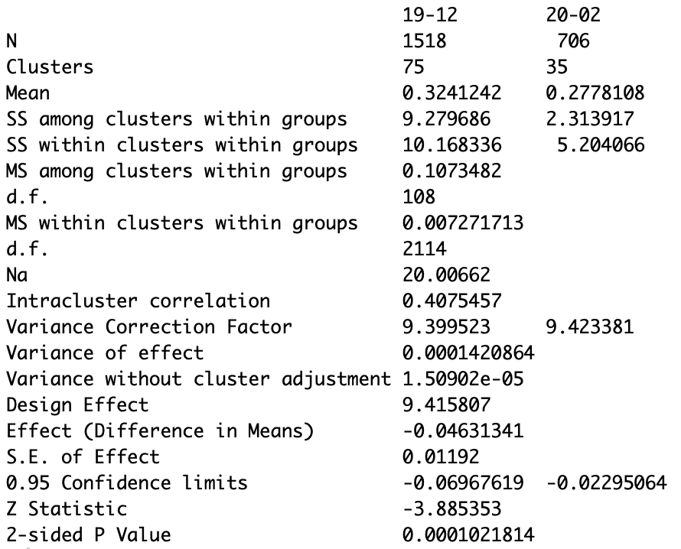
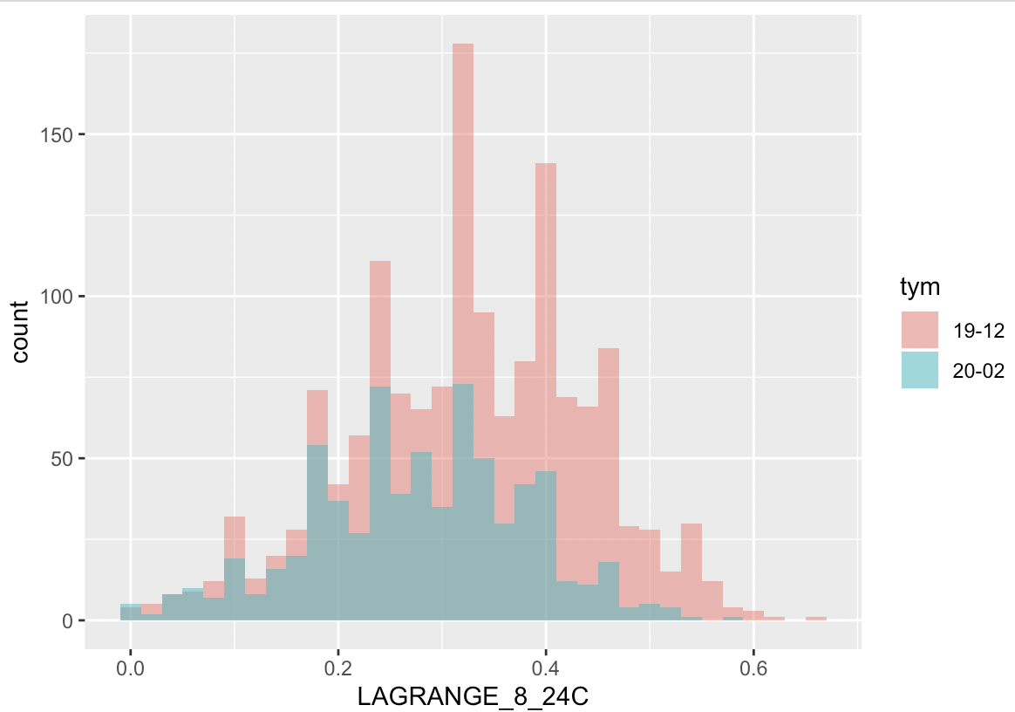
Lagrange 8-24C yield (Dec19 vs Feb20) Baseline Only No Fin Res in either group
Both groups seem to have a normal distribution
The difference in means is statistically significant

Slide 4
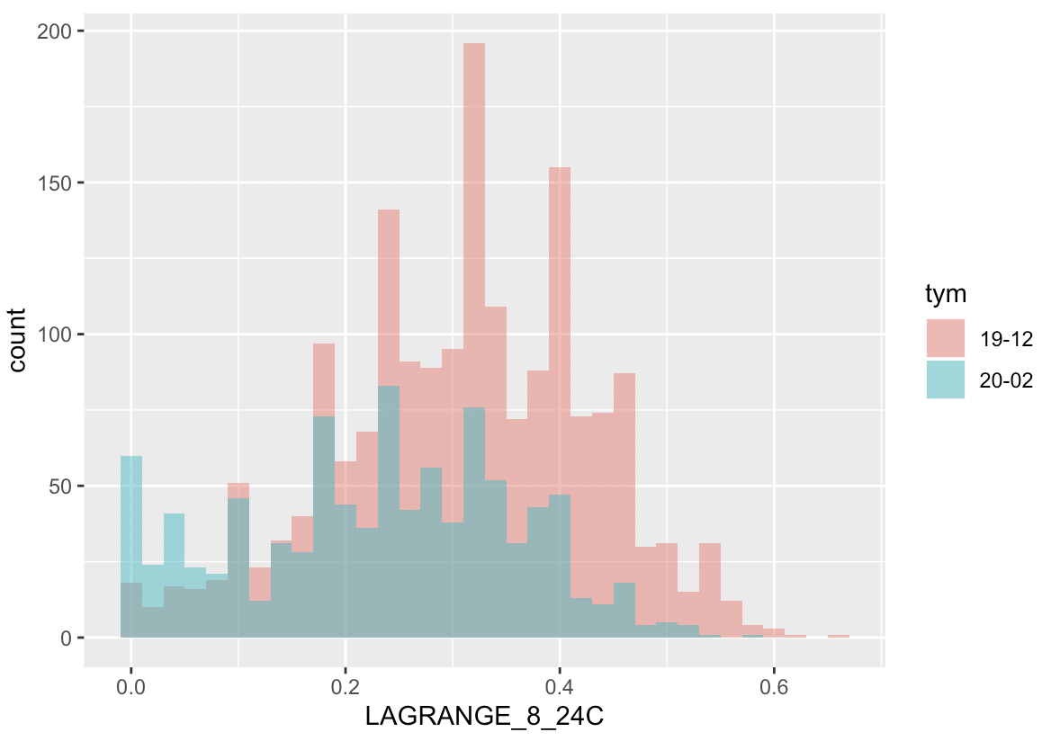
Lagrange 8-24C yield (Dec19 vs Feb20) All wafers (Not just baseline) No Fin Res in Either Group
Compare the previous histogram to the histogram with all wafers.
In both groups (especially 20-02), you can see a larger distribution at the left end of the chart. (Duh!)
What is interesting is that 20-02 has a MUCH larger increase at the LHS of the chart probably due to the same issue that is impacting Sail.
Therefore, not only do we have more terrible wafers in Feb20, the baseline yield of the wafers in Feb20 is also degraded.
Why?

Slide 5
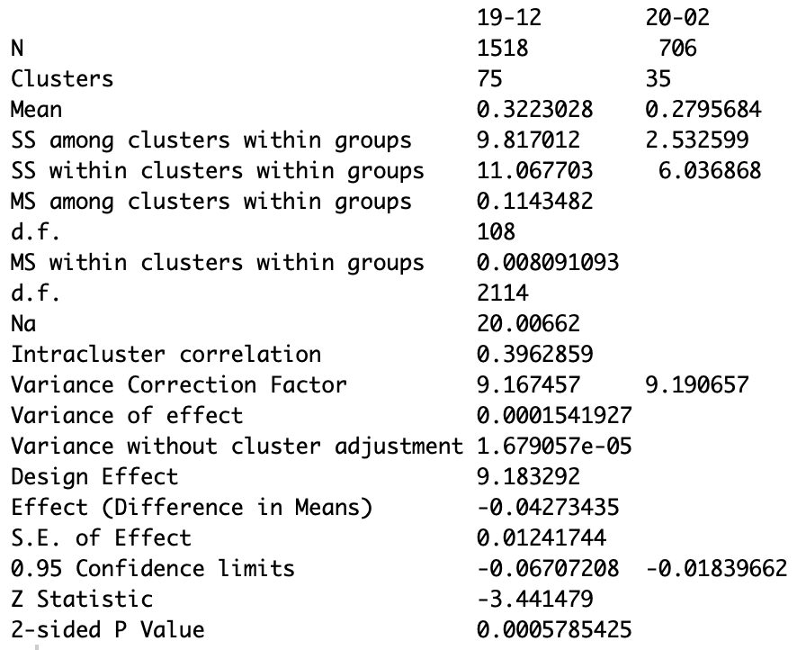
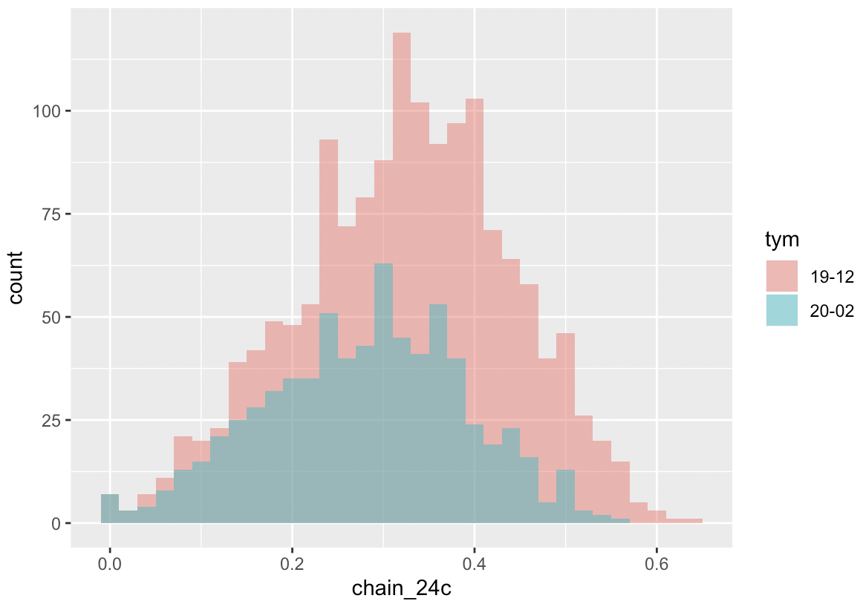
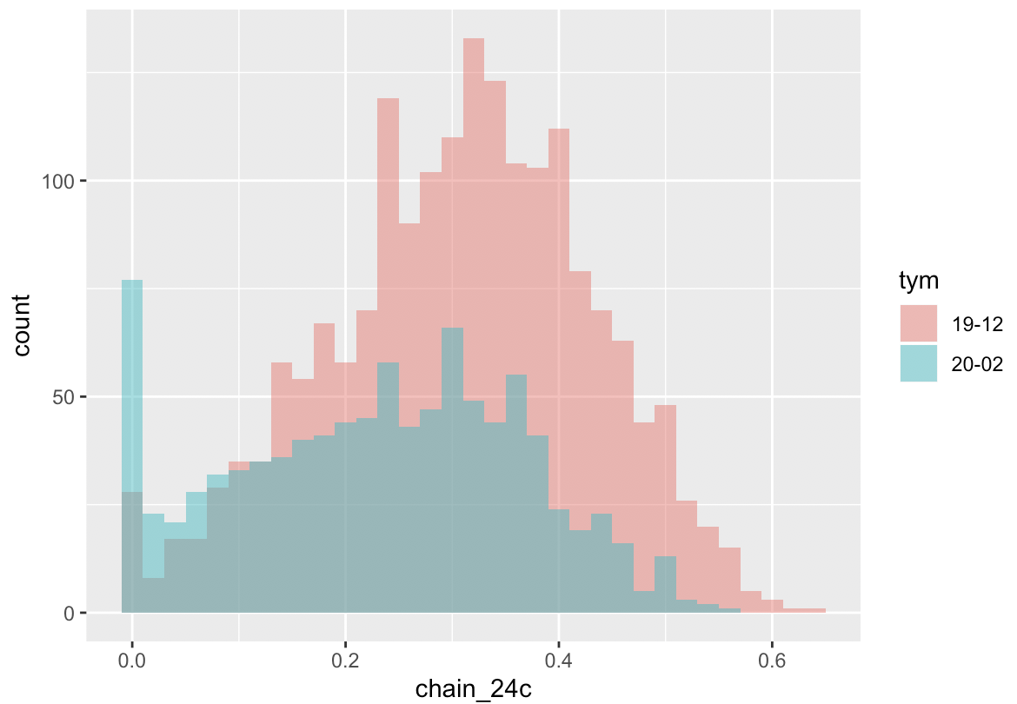
Chain_24c yield (Dec19 vs Feb20) tells a similar story
However, if you look at the 20-02 histogram, you can see a slight skew to the right. This skew might exist in 19-12 as well.
Jonathan’s pareto was able to filter out the signatures that were decimating the 24c chain yield
However, there seems to be something that is subtly impacting the 24c chain yield that is not filtered out.
Baseline Only
All Wafers

Slide 6
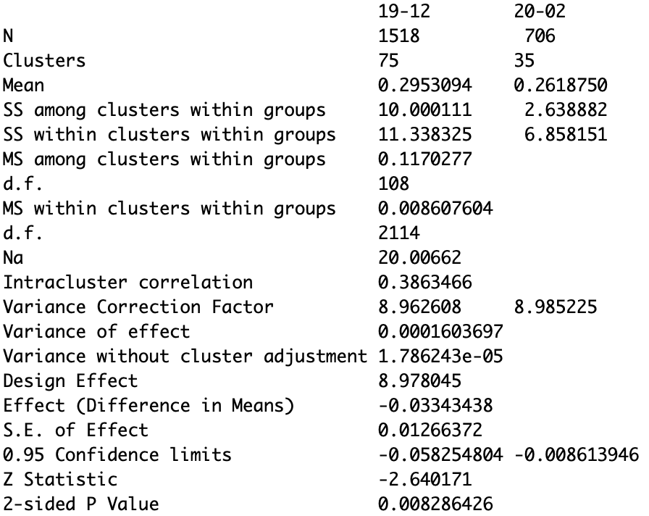
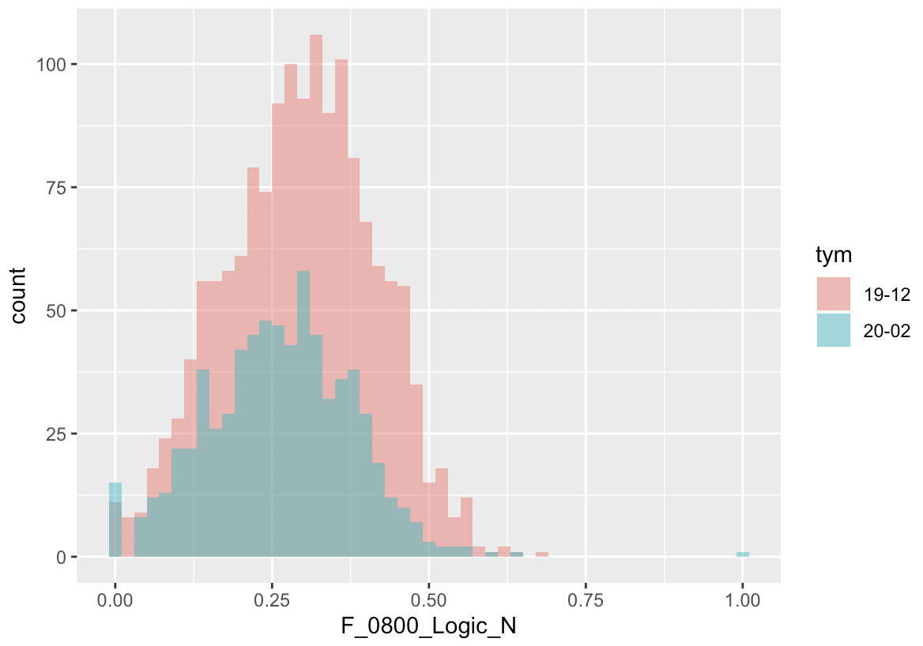
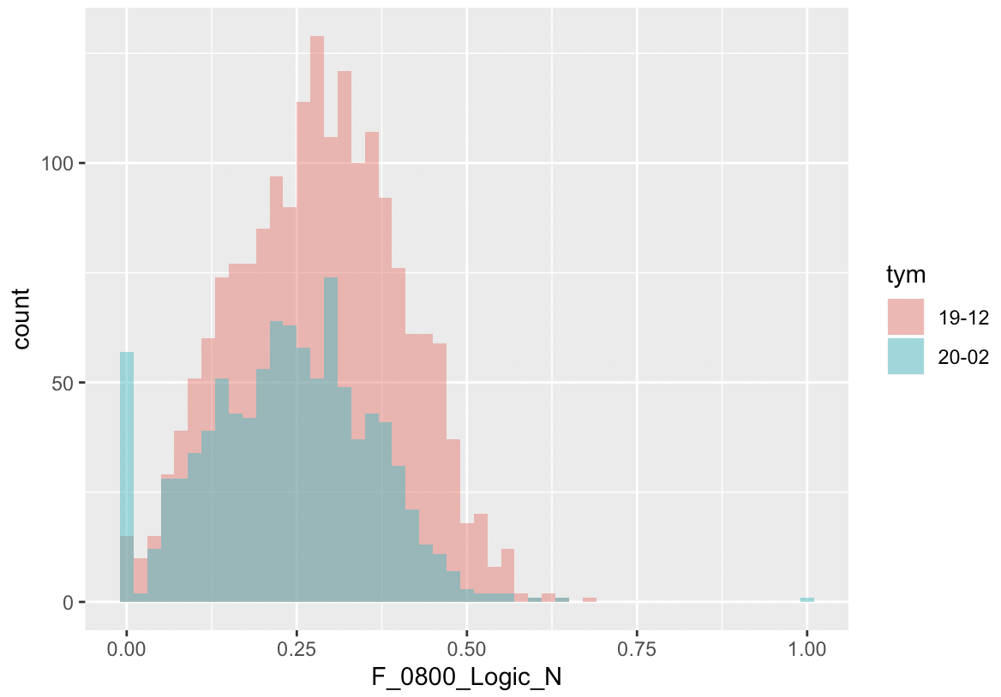
Logic yield (Dec19 vs Feb20) also tells a similar story
Maybe like 24c chain yield, there is also a right skew to the 20-02 Logic Yield that isn’t as obvious as the 19-12 logic yield.
Not as obvious as 24c chain yield though.

Slide 7
Update:
Cheng Tin did and some additional screening filtered out more wafers from the Baseline group

Slide 8
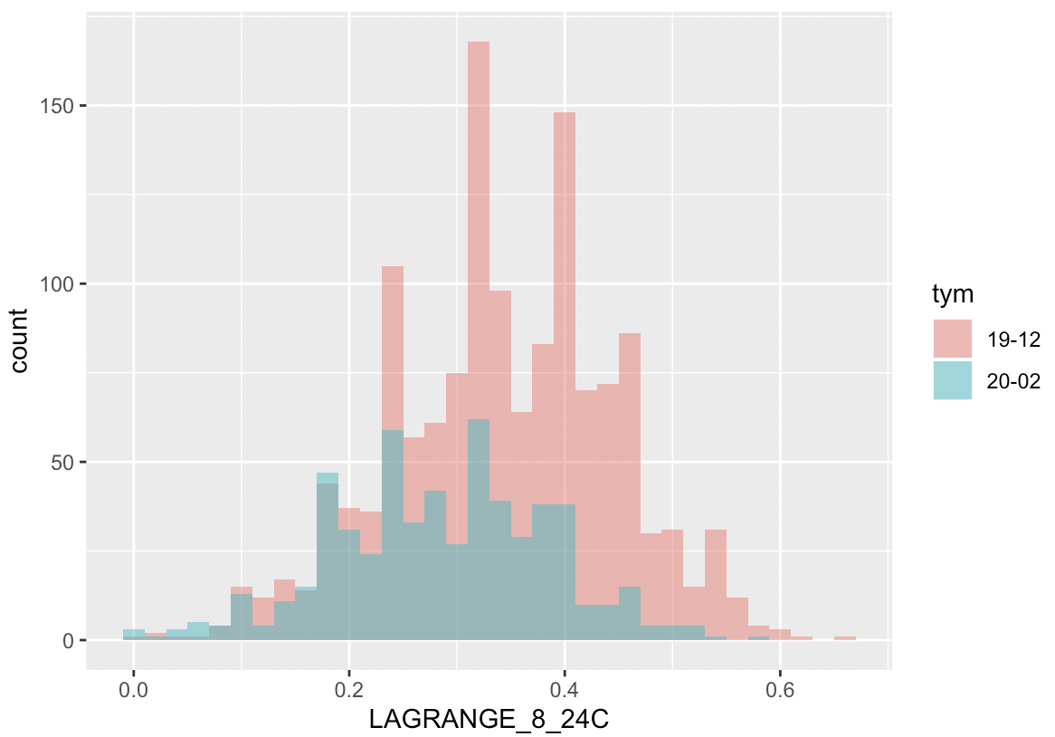
Before Cheng Tin filter
After Cheng Tin filter
Not much changed, the means just shifted to the right for both groups

Slide 9
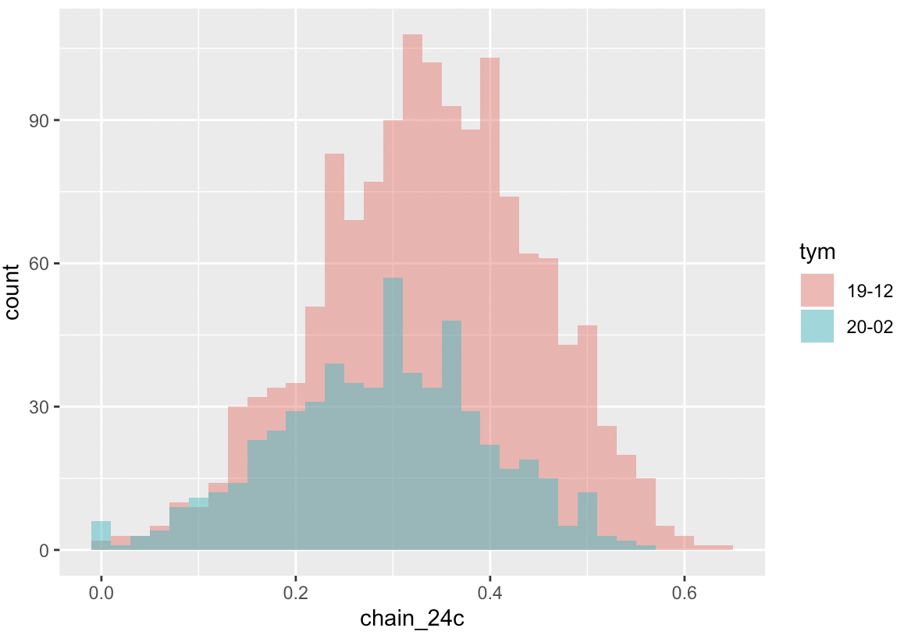
Before Cheng Tin filter
After Cheng Tin filter
It looks like some of the skew has been removed by the extra filter.

Slide 10
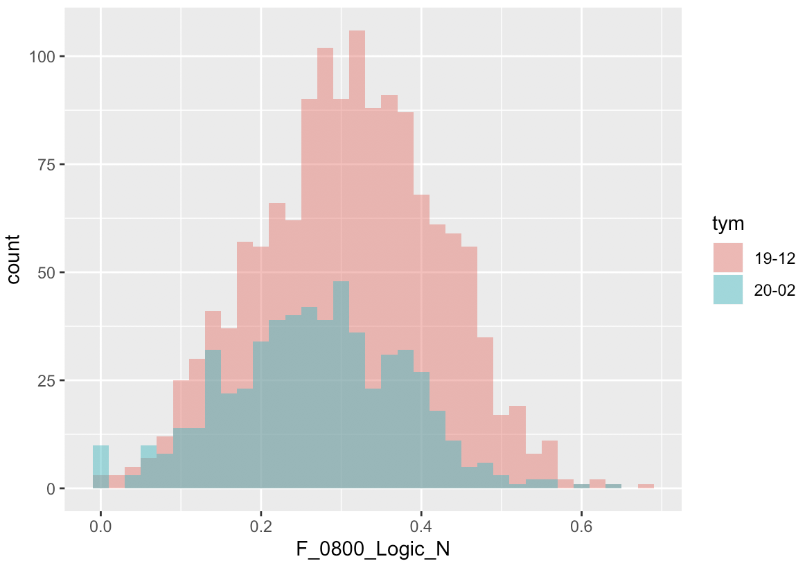
Before Cheng Tin filter
After Cheng Tin filter

